Slide 1
On the typology of
the attrition and loss of
PAn *<um> AV marking:
A Mandailing-Batak perspective
Yuchen li & I wayan arka
ALS2025 presentation

Slide 2
introduction
1

Slide 3
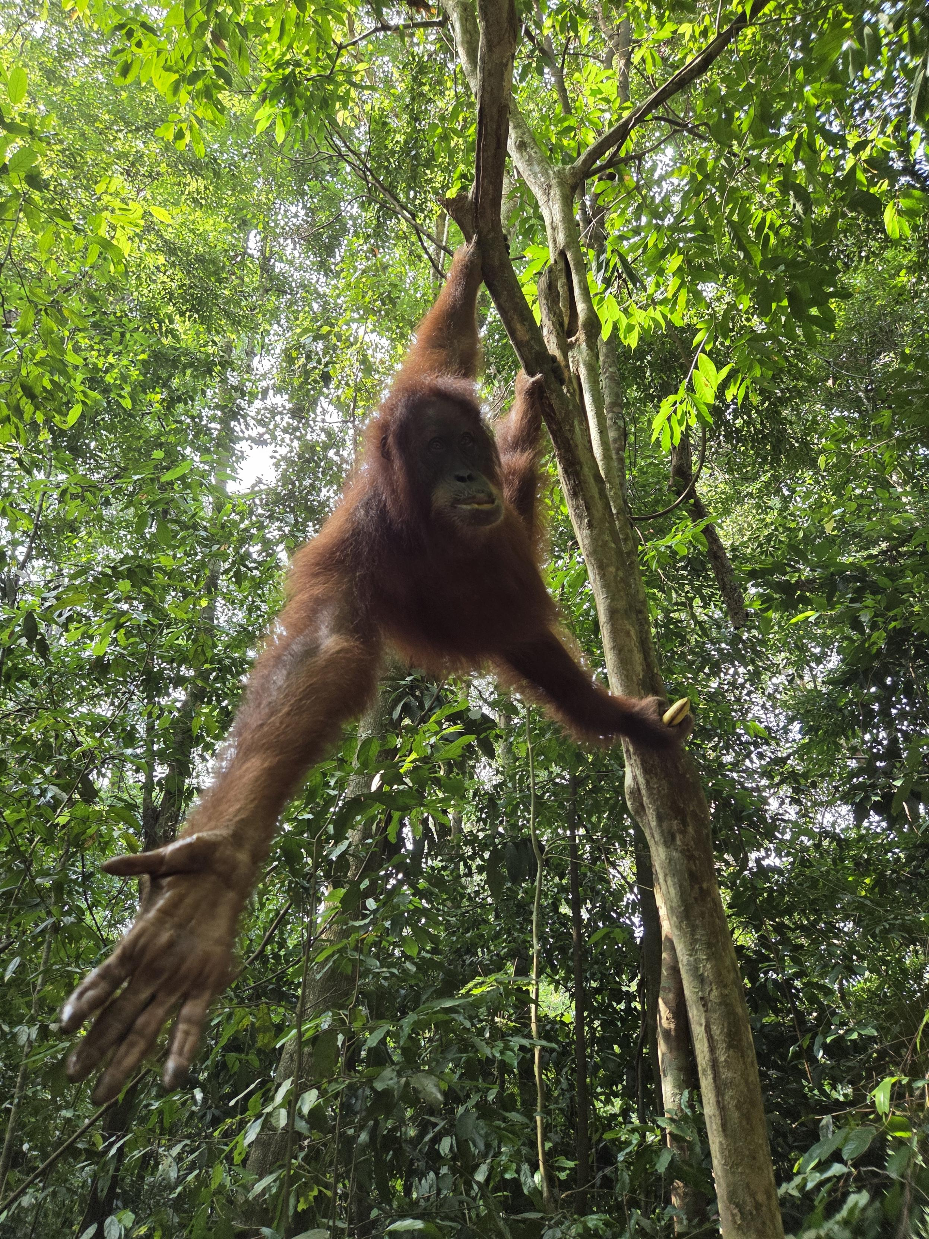
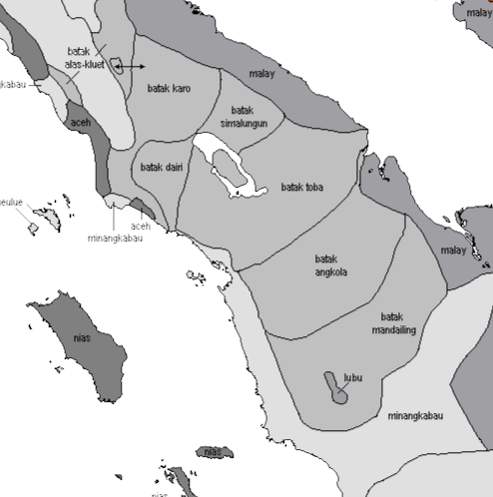
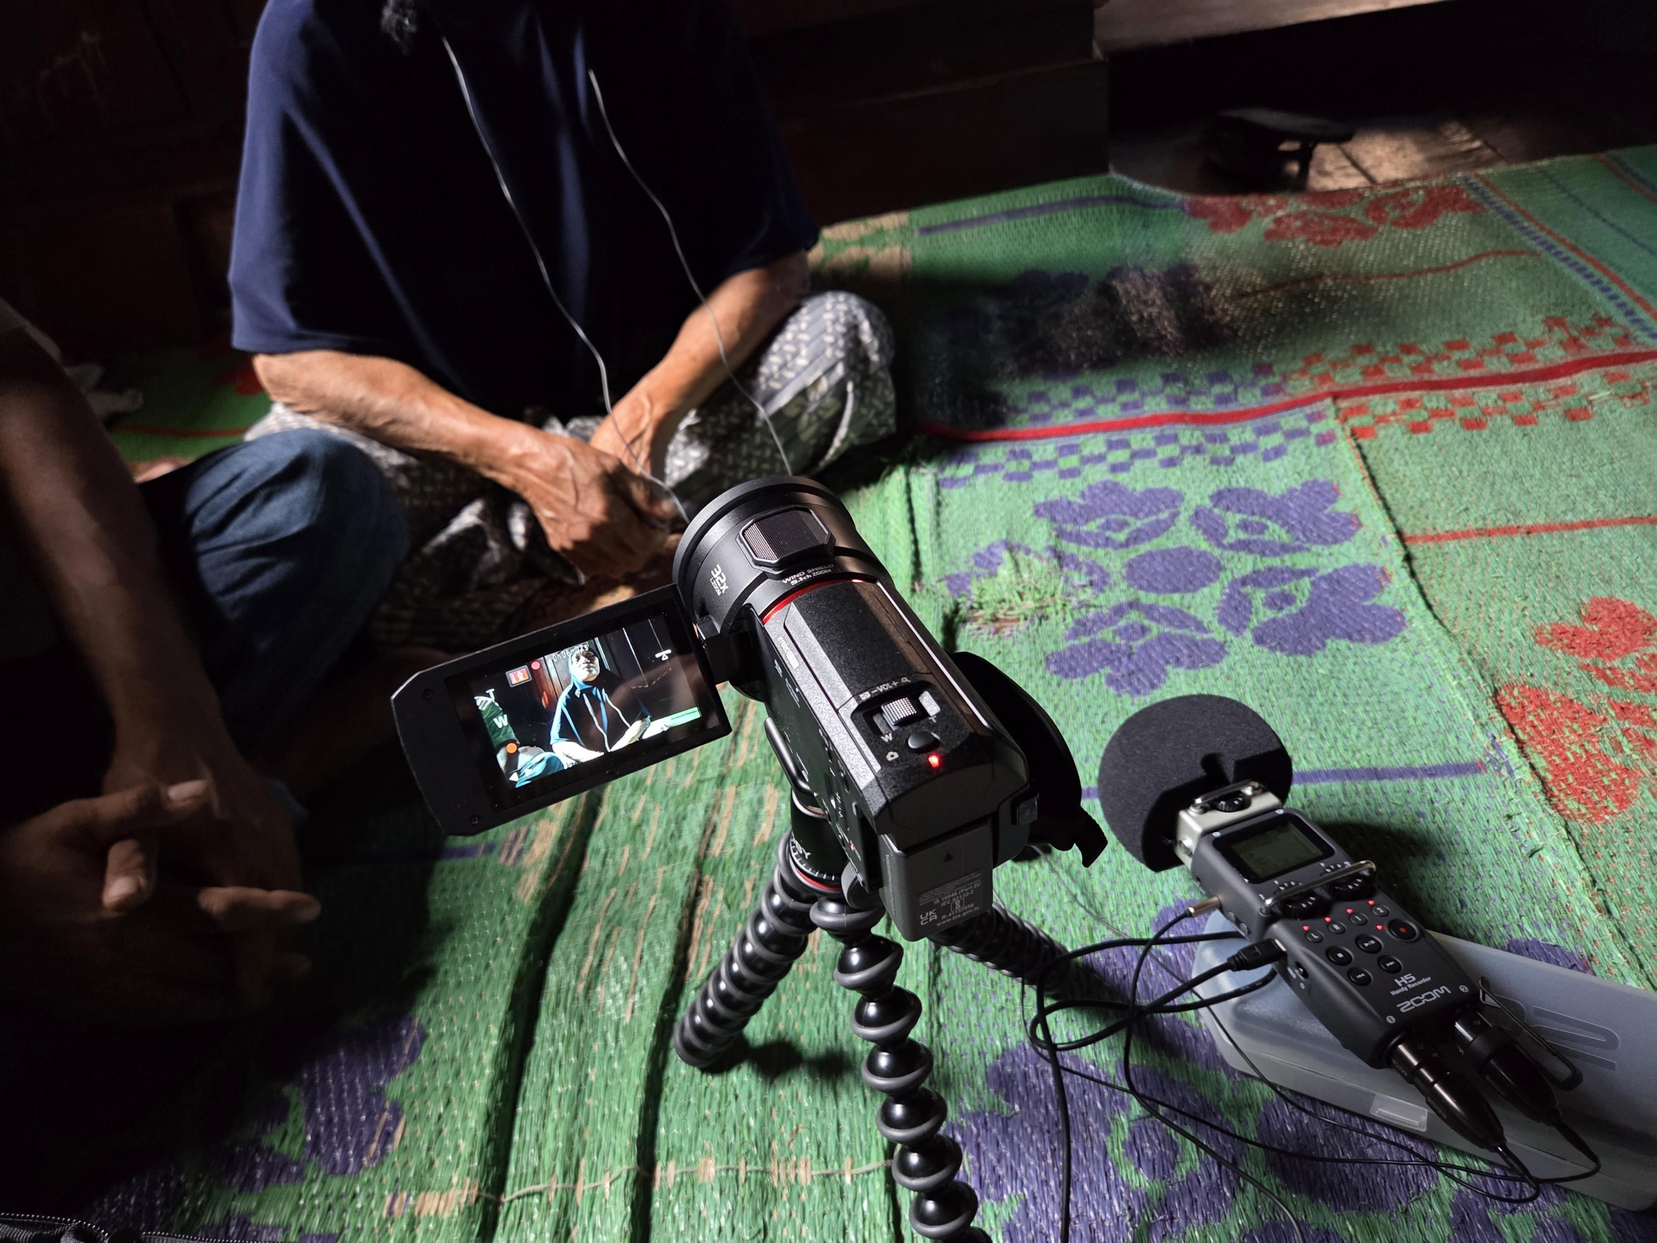
Before We Start…
An ‘Austronesianist’ talk with some ‘Austronesianist’ jargons
PAn: Proto-Austronesian (Formosan + Malayo-Polynesian)
PMP: Proto-Malayo-Polynesian (Sumatran + Others)
Mandailing: A Sumatran language with symmetrical voice
Actor voice (Austronesian)/Active voice (e.g. English):
A AV P
Subj Verb Obj
Passive voice (e.g. English):
P PV (A)
Subj Verb Oblique
Undergoer voice (Austronesian):
P UV A
Subj Verb Obj -> No valency change!
Retrieved from https://www.muturzikin.com/cartesasiesudest/9.htm

Slide 4
*<um> and Reflexes in Austronesian Languages
*<um>: Proto-Austronesian (PAn) ‘actor voice’ (Blust, 2013, pp. 383-385)
Almost always intransitive in PAn reconstructions, e.g.
*C<um>aŋis ‘to weep, cry’ *k<um>aen ‘to eat’
*N<um>aŋuy ‘to swim’ *q<um>uzan ‘to rain’
Reflexes of *<um> in modern Austronesian languages:
In Formosan and some Philippine-type languages
They do ‘nearly all of the work of marking actor voice’
In some other extra-Formosan Philippine-type languages
*<um> & PMP *maN- reflexes share the AV functions, e.g.
Kelabit: n-urun ‘to lower something’ vs t<əm>urun ‘to descend’ (different transitivity)
Malagasy: man- in most verbs vs <om> in e.g. h<om>ana ‘to eat’ (different productivity)
In many other Western Malayo-Polynesian languages
*<um> reflexes are less like ‘voice markers’, e.g.
Tindal Dusun: gayo ‘big’ vs g<um>ayo ‘to become big(ger)’ (inchoative)
Malay: guruh ‘thunder’ vs g<əm>uruh ‘to rumble, of thunder’ (semi-fossilised)

Slide 5
Overview
A brief synchronic description of morphemes consisting of PAn *<um> reflexes in Mandailing
A brief summary of the historical development of PAn *<um> into Mandailing
Two research questions:
Which function(s) of PAn *<um> is/are retained in Mandailing?
Which function(s) of PAn *<um> has/have changed in Mandailing and how?
PAn |  | PMP |  | Mandailing
Form | Function | Form | Function | Form | Function
*<um> | AV | *<um> | AV | <um> | intransitive
 |  |  |  | ma-¹ | inchoative
 |  |  |  | m- | intransitive
*ma-¹ | DYN.int | *maŋ- | AV.pl | maN- | AV
 |  |  |  | mangka- | distributive
 |  | *maR- | AV.mid | mar-¹ | middle
 |  |  |  | mar-² | verbaliser
*ma-² | STAT.int | *ma-² | STAT.int | ma-² | intransitive

Slide 6
a SYNCHRONIC GLANCE
2

Slide 7
Mandailing Morphemes Potentially Consisting of *<um> Reflexes
Function | Form | Voice-marking | Actor-salience | Transitive
int | <um> | - | - | -
AV | maN- | + | + | +
MID | mar- | + | + | -
VLS | mar- | - | + | -
DYN.int | ma- | - | - | -
STAT.int | ma- | - | + | -
DIST.int | mangka- | - | - | -
int | m- | - | - | -

Slide 8
The ‘Canonic’ <um>
Very marginal & primarily in traditional/written texts
No longer expresses actor salience (as in PAn)
Intransitive, e.g.
(1) boti ilu=na pe s<um>arsar
CONJ tear=3sg.poss also <um>scatter
‘And his tears also dropped.’
No longer a voice marker
In voice-marked verbs, e.g.
(2) pala borngin ipi-ipi-an
otherwise night dream-RED-APPL
t<um>ar-ingot-i anak a>olong<an
<um>UV.INVOL-remember-APPL child <SUP>dear
‘Otherwise, at nights she kept dreaming, recalling her favourite child.’

Slide 9
The ‘WMP’ maN-
Most AV-like affix in Mandailing as a symmetrical voice language:
Promotes the A of a verb to the syntactic pivot (vs UV)
Compatible with all transitive verbs but causatives with pa-
Mostly with transitive verbs, e.g.
(3) petrus mam-baca buku on
PN maN-read book DEM.PROX
‘Petrus reads this book.’
Sometimes also with intransitive verbs, e.g.
(4) mang-idup ia tiop ari
maN-smoke 3sg every day
‘(S)he smokes every day.’

Slide 10
The Middle Voice Marker mar-
As a middle voice marker (like Indonesian ber-):
In complementary distribution with AV/UV affixes
Linked to middle-marked events in Kemmer (1993, pp. 267–270)
Event | Mandailing middle verb | English translation
Grooming | marcukur | ‘to shave’
 | marpakean | ‘to dress’
Translational motion | marguling | ‘to roll’
 | marlojong | ‘to run’
Cognition | marpikir | ‘to think’
Direct reflexive | marsuomin | ‘to see oneself (in the mirror)’
Logophoric reflexive | maraso | ‘to feel’
Naturally reciprocal event | marsuo | ‘to meet’
Body action | martata | ‘to laugh’

Slide 11
The Verbaliser mar-
To form a verb with a noun meaning ‘to have/use the noun’, e.g.
marabit ‘to get dressed’ from abit ‘cloth’, e.g.
(5) madung mar-abit ia kehe tu horja
already mar-cloth 3sg go to party
‘(S)he already got dressed and went to the party.’
May take an additional UV marker, but mar- becomes par-, e.g.
(6) ulang ni-par-abit seragam sikola di bagas da
NEG.IMP UV-par-cloth uniform school at home EMP
‘Don’t wear school uniform at home, okay?’
-> You may see such m/p alternations a couple more times later

Slide 12
The Intransitive ma-
Attached to adjectives -> Inchoative/stative, e.g.
(7) ma-hiang aek ni saba
ma-dry water POSS rice.field
harani musim logo
because seaso dry
‘The water in the rice field dried up because of the dry season.’
Attached to dynamic verbs -> Unaccusative (no overt agent), e.g.
(8) ma-dabu mangga ngon batang
ma-fall mango from tree
‘The mango dropped from the tree.’
VS
(9) u=dabu-on mangga i ngon batang
1sg.A=fall-CAUS mango DEM from tree
‘I dropped the mango from the tree.’

Slide 13
The Distributive mangka-
Attached to dynamic intransitive stems (cf. unaccusative ma-)
Extremely rare & mostly (if not only) in traditional/written texts
(10) mangka-dabu jambu i
mangka-fall fruit DEM.DIST
i-baen alogo na gogo
UV-make wind REL strong
‘The strong wind made the fruits fall.’
(11) mangka-pultak i jia-jia
mangka-crack LOC where-RED
‘(The land) cracked everywhere.’

Slide 14
The Intransitive Initial m-
Found in very few intransitive verbs, e.g. mekel ‘to laugh’ = ekel
Related to m/p alternation in three cases:
1. mangan ‘to eat (something)’ vs pangan ‘to eat SOMETHING’
mangan ambitransitive & cannot take any voice marker
pangan strictly transitive & can take UV e.g.
(12) i-pangan anjing i uting i
UV-p.eat dog DEM.DIST cat DEM.DIST
‘The dog is eating the cat.’ (*imangan anjing i uting i)
2. modom ‘to sleep’ vs papodom ‘to make someone sleep’
m- initial becomes p- when causativised with pa-
3. maridi ‘to bathe’ vs paridi ‘to bathe someone’
Looks like another pair of ma- vs pa- but ridi never occurs alone

Slide 15
A diachronic exploration
3

Slide 16
Four (or Five) Historical Morphemes
(Kaufman, 2009, 2018; Blust, 2013; Ross, 2015)
Four reconstructed PAn morphemes
*<(a)ŋ>: Distributive infix *<(a)R>: Middle infix
*pa-: Causative prefix *ka-: Stative prefix
Inner vs outer *pa-: Inner pa- more like verbaliser & obligatory
Dynamic *ma-¹ < *p<um>a- (inner *pa- + AV *<um>)
Stative *ma-² < *k<um>a- (stative *ka- + AV *<um>)
In PMP, to resolve such syncretism, two morphemes replaced ma-¹
AV (int/mid) *maR- < *p<um>a<R>-
AV (trans/plural) *maŋ- < *p<um>a<ŋ>-

Slide 17
*<um> Reflexes in Mandailing: maN-
AV maN- from PMP *maN- (*<um> + *pa- + *<(a)N>)
Functions reflecting PAn *<um>: Voice-marking & Actor-salience
Has lost most of the plurality connotation of *<(a)N>
(15) tiop alak mam-baca buku-na
every person maN-read book-3sg.poss
‘Everyone reads their own book.’
We had some clearer examples before, e.g.
(16) ma-ng-ka-dabu jambu i
p<um>a-N-ka-fall fruit DEM.DIST
i-baen alogo na gogo
UV-make wind REL strong
‘The strong wind made the fruits fall.’

Slide 18
*<um> Reflexes in Mandailing: mar-
MID mar- from PMP *maR- (*<um> + *pa- + *<(a)R>)
Functions reflecting PAn *<um>: Voice, Actor-salience, & Intransitive
VLS mar- from PMP *maR- (*<um> + *pa- + *<(a)R>)
*pa- in VLS mar- similar to inner *pa- in PAn
In Mandailing, mar- becomes par- in UV
Functions reflecting PAn *<um>: Actor-salience & Intransitive
-> *<um> reflex m- taken away in transitive/UV
Functions different from PAn *<um>: Derivational & Non-voice

Slide 19
*<um> Reflexes in Mandailing: Stative ma-
Inchoative/stative ma- from PAn dynamic *ma- (*p<um>a-)
(17) i-pa-hiang ho baju i
UV-pa-dry 2sg shirt DEM.DIST
‘You dried the shirt (lit. the shirt is dried by you).’
-> Aren’t they eliminated in PMP already?
Hypothesis: A reanalysis in Mandailing
The *<um> reflex m- as a detransitiviser in Mandailing
Why only stative ma- occur in this case?
Inner vs outer causative in Mandailing
-> Inner: pa- not part of the root, but part of the verb
-> pa-hias (trans. v) vs ma-hias (int. v) vs hias (adj) ‘clean’
-> Outer: pa- neither part of the root nor part of the verb
-> pa-use (trans. v) vs use (int. v) vs *ma-use (= use) ‘spill’

Slide 20
*<um> Reflexes in Mandailing: Dynamic ma-
Unaccusative/dynamic ma- from PMP stative *ma- (*k<um>a-)
Function reflecting PAn *<um>: Intransitive
ma-² & mangka- occur with the same stems -> Same underlying *ka-
mangka- -> maN- + ka- (ka- = ma- - *<um>)
maN- occurs to express plurality/distributiveness
*<um> reflex m- in ma- deleted to avoid double expression
mangka- is a variant of dynamic ma- with maN- but
-> mangka- ‘distributive intransitive dynamic prefix’
In PAn dynamic *ma- (*p<um>a-) vs stative *ma- (*k<um>a-)
In PMP dynamic *maŋ-/maR- vs stative *ma- (*k<um>a-)
In Mandailing dynamic ma- (*k<um>a-) vs stative ma- (*p<um>a-)

Slide 21
*<um> Reflexes in Mandailing: m-
mangan from pangan (*p<um>angan) ‘to eat’
pangan strictly transitive
modom from podom (*p<um>odom) ‘to sleep’
modom is strictly intransitive
maridi from paridi (*p<um>aridi) ‘to bathe’
A PAn inner *pa- fossilised in the transitive stem
-> *<um> reflex m- relates to lower transitivity
-> The same function as m- as in ma-¹ (*p<um>a-)

Slide 22
Conclusion
How have the historical functions of *<um> retained or changed in its reflexes in Mandailing?
R - RETAINED; C - CHANGED (provisional & hypothetical mapping)
*<um> reflexes have become less like an actor voice marker, but have been increasingly used as a detransitiviser
Function | Form | Voice-marking | Actor-salience | Transitive
int | <um> | C | C | R
AV | maN- | R | R | C
MID | mar- | R | R | R
VLS | mar- | C | R | R
DYN.int | ma- | C | C | R
STAT.int | ma- | C | R | R
DIST.int | mangka- | C | C | R
int | m- | C | C | R

Slide 23
Discussion
So: polysemous or homonymous ma-?
Historically at least two sources: *p<um>a- & *k<um>a-
Synchronically also two sources:
One historically from *k<um>a-
One as an independent innovation with underlying *p<um>a-
A converged broader intransitive domain with two sub-senses
mangka- vs ipa- straightforward without looking at etymology
Still an empirical question for the next stage of elicitation/corpus work
To be tested with larger verb lists + productivity judgements

Slide 24
Acknowledgement
I would like to thank
Wayan for his contribution to this work
Beth for proofreading and commenting on the slides
My cohort in our project, Emma, Keira, and Marcel, for their feedbacks
Stephen for offering advice as my ALS mentor
Laura and LING9001 students, Elliot, Michael, and Yue, for our inspiring discussions
Danielle for offering the CHL ALS attendance grant
ALS for offering the ALS student conference attendance support grant
Sumi and Tapsir for being my local research/field assistants in North Sumatra
Pak Namsyah for being my Indonesian teacher and local contact in Medan
All my Mandailing speakers in Mandailing Natal and Medan

Slide 25
References
Adelaar, K. A. (1981). Reconstruction of Proto-Batak phonology. In R. A. Blust (Ed.), Historical linguistics in Indonesia: Part 1 (pp. 1–20). Universitas Katolik Indonesia Atma Jaya.
Billings, B., & McDonnell, B. (2024). Sumatran. Oceanic Linguistics, 63(1), Article 1.
Blust, R. A. (2013). The Austronesian languages. Asia-Pacific Linguistics. https://openresearch-repository.anu.edu.au/handle/1885/10191
Hutasuhut, A., Nasution, C., Sarisrianti, S., & Hidayat, Z. (2016). Kamus Angkola Mandailing-Indonesia ed. 2.
Kaufman, D. A. (2009, June 22). On Austronesian *pa-, *paR- and *paN-. Paper Presented at the Eleventh International Conference on Austronesian Linguistics (11-ICAL). the Eleventh International Conference on Austronesian Linguistics (11-ICAL), Aussois, France.
Kaufman, D. A. (2018). Inner and outer causatives in Austronesian: A diachronic perspective. McGill Working Papers in Linguistics, 25(1), 201–215.
Kemmer, S. (1993). The middle voice. John Benjamins.
Nababan, P. W. J. (1981). A grammar of Toba-Batak. Dept. of Linguistics, Research School of Pacific Studies, The Australian …. (Original work published 1958–1966)
Nothofer, B. (1986). The Barrier island languages in the Austronesian language family. In P. Geraghty, L. Carrington, & S. A. Wurm (Eds.), Focal II: Papers from the fourth international conference on Austronesian linguistics (pp. 435–490). Pacific Linguistics. https://doi.org/10.15144/PL-C94.87
Percival, W. K. (1981). A grammar of the urbanised Toba-Batak of Medan. Dept. of Linguistics, Research School of Pacific Studies, The Australian …. (Original work published 1964)
Ross, M. (2015). Reconstructing proto Austronesian verb classes. Language and Linguistics, 16(3), 279–345.
Smith, A. D. (2017). The Western Malayo-Polynesian problem. Oceanic Linguistics, 435–490.
Van der Tuuk, H. N. (1971). A Grammar of Toba Batak (J. Scott-Kemball, Trans.). Springer. (Original work published 1864–1867)

Slide 26
Thank you all!
yuchen.li@anu.edu.au

